Slide 1

CLASSIFICATION AND VALUE ESTIMATION
“Data science does not replace statistical modeling and data analysis; it augments them.”
(P. Boily)
“Data is not information, information is not knowledge, knowledge is not understanding, understanding is not wisdom.”
(attributed to Cliff Stoll in Keeler's Nothing to Hide: Privacy in the 21st Century, 2006)
data-action-lab.com

Slide 2
Learning Objectives
Become familiar with the basic concepts of classification and value estimation; as well as some of the common algorithms.
Become familiar with one species of decision trees (ID3).
Become familiar with performance evaluation criteria for classification and value estimation methods.

Slide 3
CONTENTS
Case Study: Minnesota Tax Audit
Classification Basics
Classification Algorithms
Notes and Validation
Example: Kyphosis

Slide 4
CASE STUDY: MINNESOTA TAX AUDIT
CLASSIFICATION AND VALUE ESTIMATION
Data mining based tax audit selection: a case study of a pilot project at the Minnesota Department of Revenue
(Hsu, W., Pathak, N., Srivatsava, J., Tschida, Bjorklund, E. [2013], Real Word Data Mining Applications, Annals of Information Systems, v.17, Springer).

Slide 5
Context
Large gaps between revenue owed (in theory) and revenue collected (in practice) are problematic for governments.
Revenue agencies implement various fraud detection strategies (such as audit reviews) to bridge that gap.
Business audits are costly – are there algorithms that can predict whether an audit is likely to be successful or a waste of resources?

Slide 6
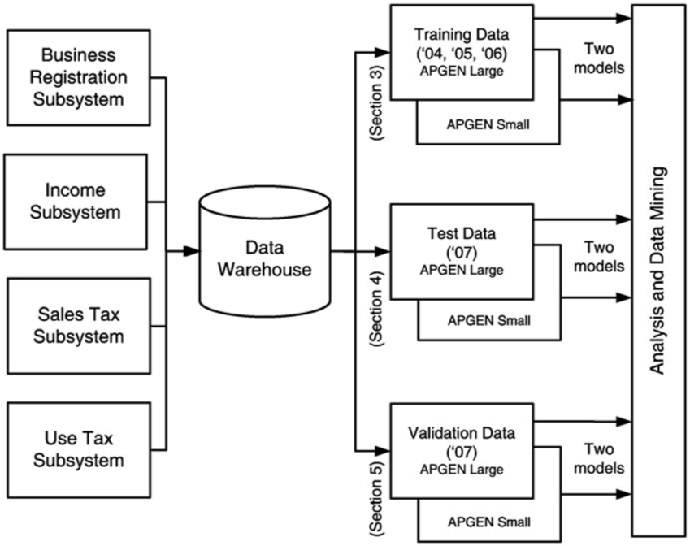

Slide 7
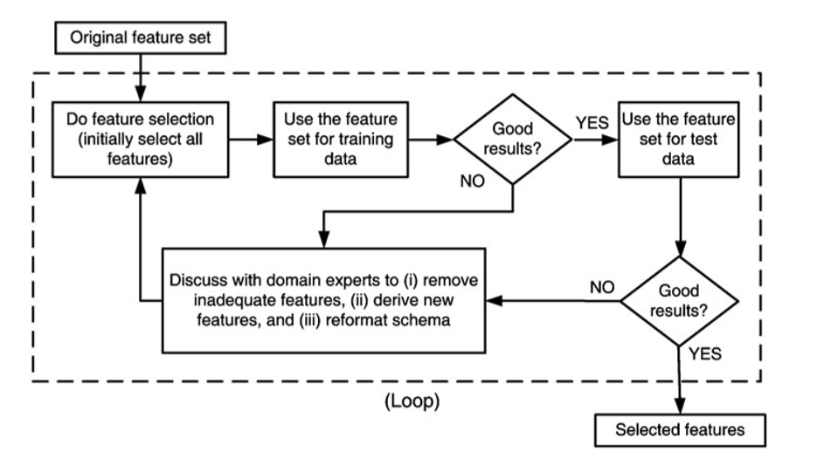

Slide 8
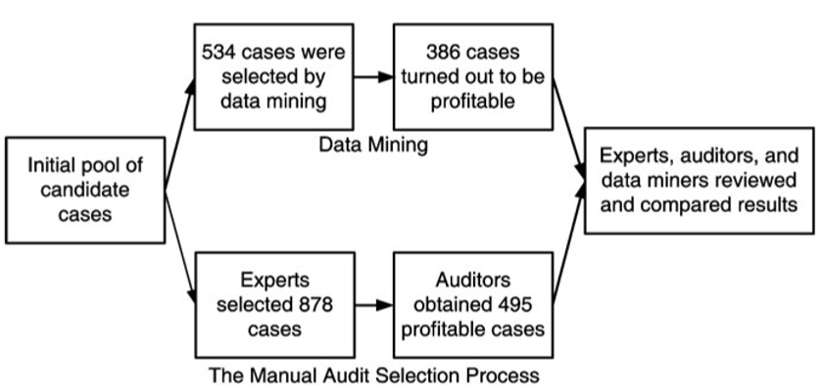

Slide 9
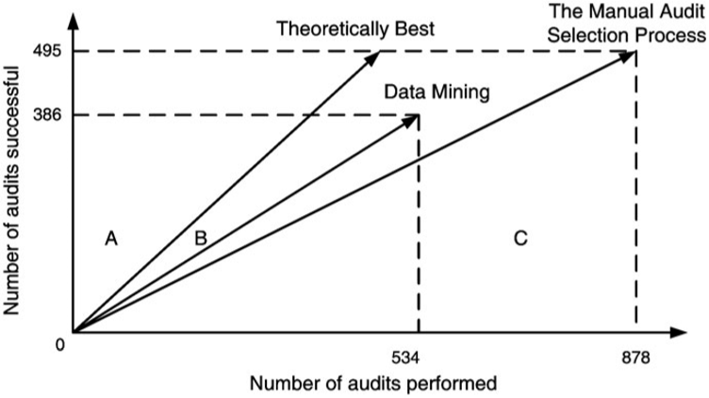

Slide 10
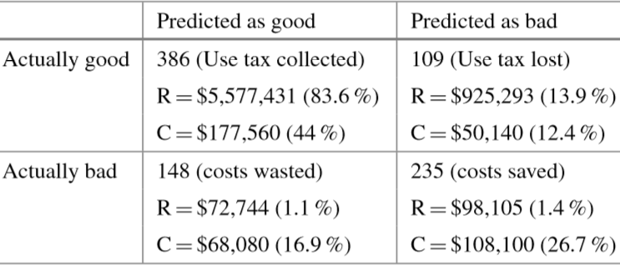

Slide 11
DISCUSSION
Should a tax collection agency seek to maximize its revenues/profits or to ensure compliance?
Notes:
Intro to text analysis
We will be talking about data reduction using NHL game between Ottawa Senators vs. Toronto Maple Leafs on February 18th of 2017

Slide 12
CLASSIFICATION BASICS
CLASSIFICATION AND VALUE ESTIMATION
“We are much too much inclined in these days to divide people into permanent categories, forgetting that a category only exists for its special purpose and must be forgotten as soon as that purpose is served.”
(Dorothy L. Sayers, Are Women Human? Astute and Witty Essays on the Role of Women in Society)

Slide 13
Classification Overview
In classification, a sample set of data (the training set) is used to determine rules and patterns that divide the data into pre-determined groups, or classes (supervised learning; predictive analytics).
The training data usually consists of a randomly selected subset of the labeled (target) data.
Value estimation (regression) is akin to classification when the target variable is numerical.

Slide 14
Classification Overview
In the testing phase, the model is used to assign a class to observations for which the label is hidden, but ultimately known (the testing set).
The performance of a classification model is evaluated on the testing set, never on the training set.
Technical issues include:
selecting the features to include in the model
selecting the algorithm
etc.

Slide 15
Applications
Medicine and Health Science
predicting which patient is at risk of suffering a second, fatal heart attack within 30 days based on health factors (blood pressure, age, sinus problems, etc.)
Social Policies
predicting the likelihood of requiring assisting housing in old age based on demographic information/survey answers
Marketing and Business
predicting which customers are likely to switch to another cell phone company based on demographics and usage

Slide 16
Other Uses
Predicting that an object belongs to a particular class.
Organizing and grouping instances into categories.
Enhancing the detection of relevant objects
avoidance: “this object is an incoming vehicle”
pursuit: “this borrower is unlikely to default on her mortgage”
degree: “this dog is 90% likely to live until it’s 7 years old”
In the absence of testing data, classification may be descriptive but not predictive.

Slide 17
Examples
Scenario:
A motor insurance company has a fraud investigation dept. that studies up to 30% of all claims made, yet money is still getting lost on fraudulent claims.
Questions: can we predict
whether a claim is likely to be fraudulent?
whether a customer is likely to commit fraud in the near future?
whether an application for a policy is likely to result in a fraudulent claim?
the amount by which a claim will be reduced if it is fraudulent?

Slide 18
Examples
Scenario:
Customers who make a large number of calls to a mobile phone company’s customer service number have been identified as churn risks. The company is interested in reducing said churn.
Questions: can we predict
the overall lifetime value of a customer?
which customers are more likely to churn in the near future?
what retention offer a particular customer will best respond to?

Slide 19
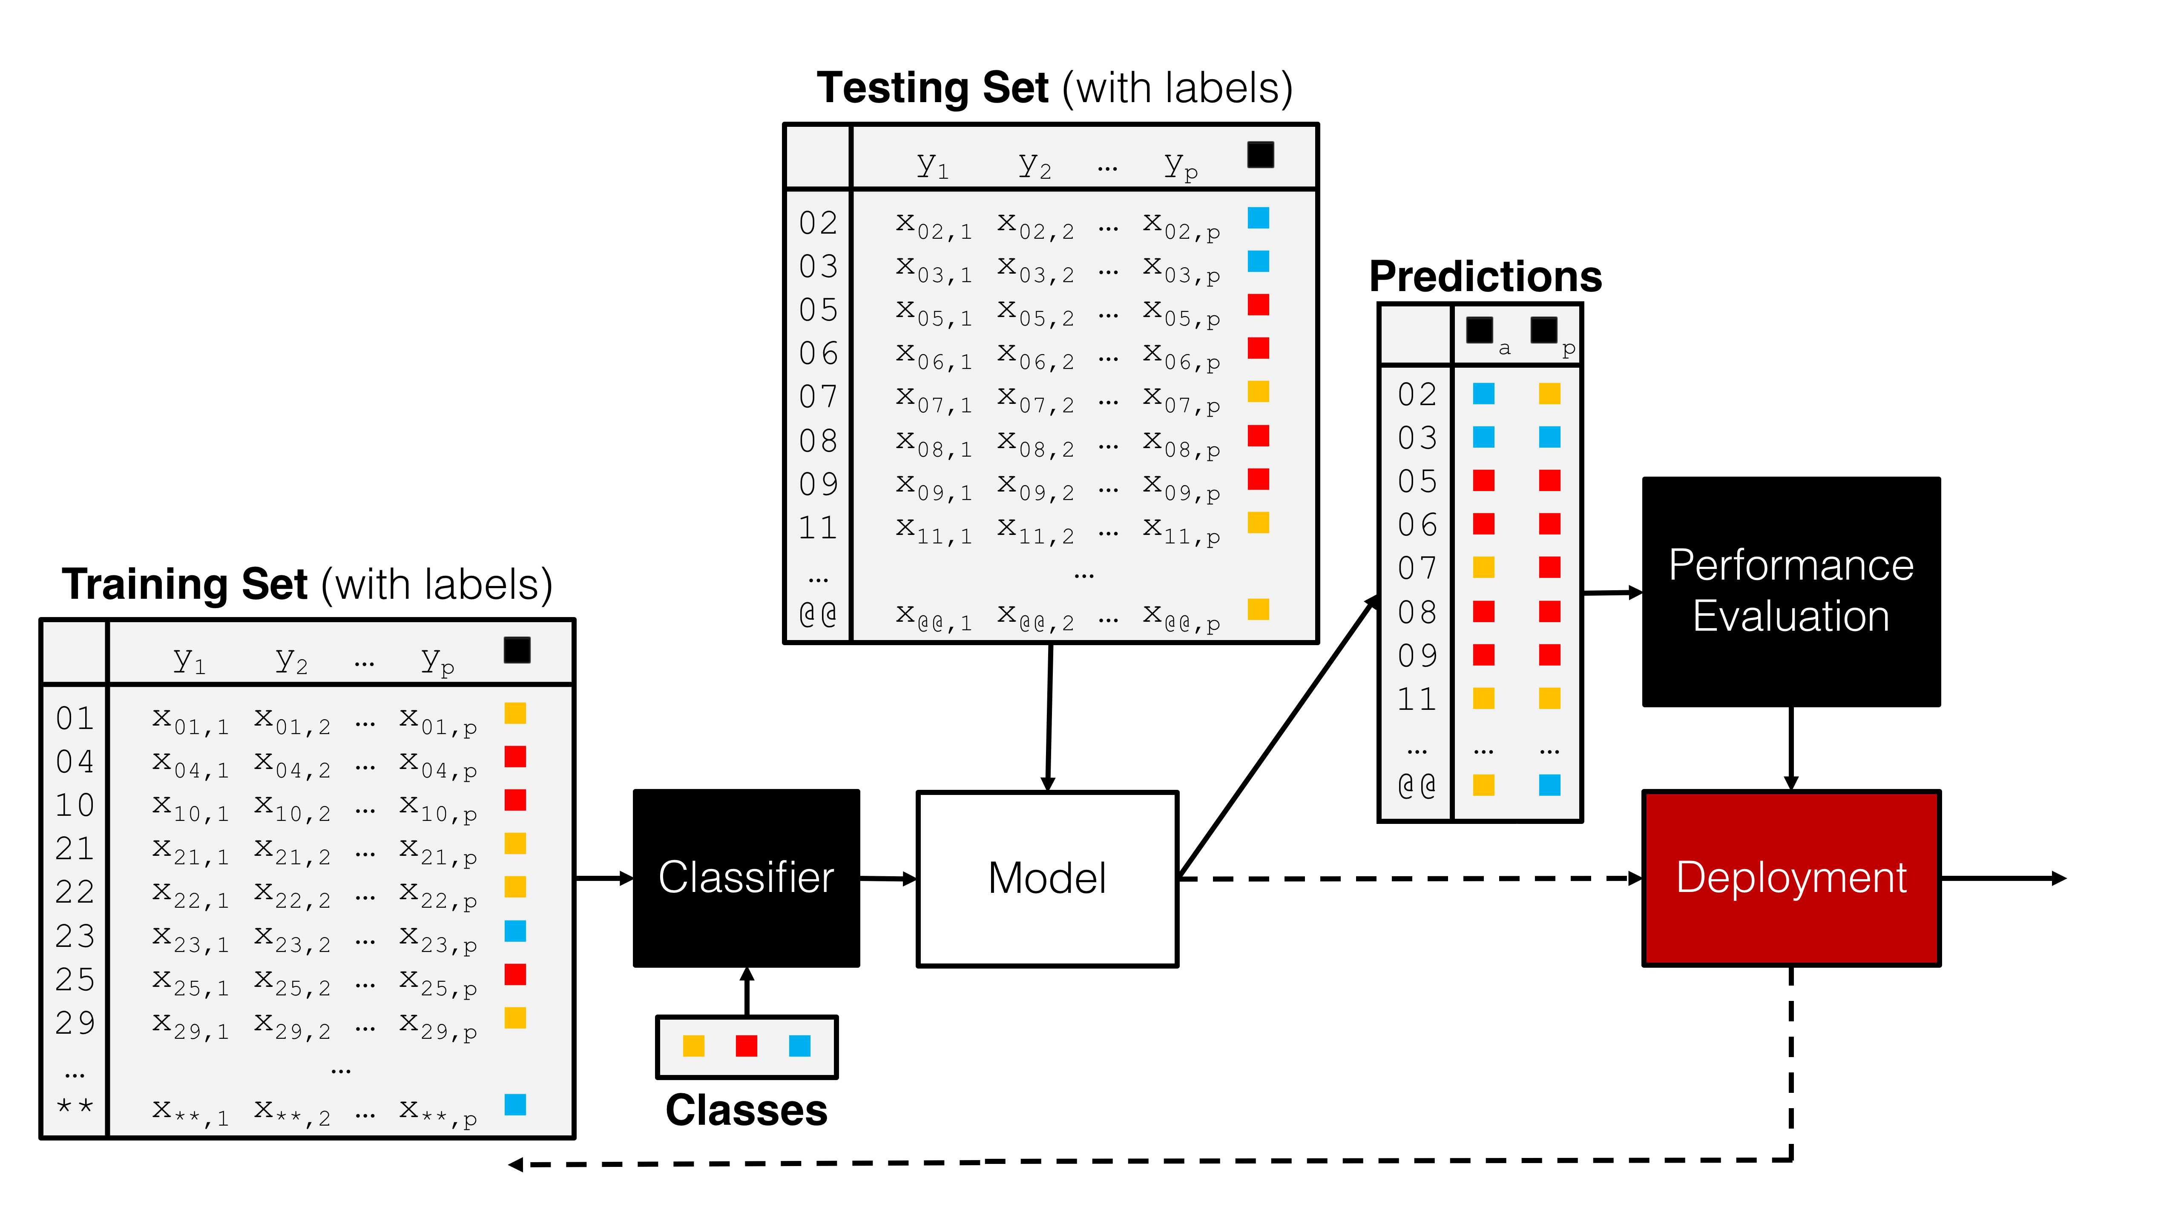

Slide 20
EXERCISE
How would you use standard statistical modeling techniques to answer these questions?
Notes:
Intro to text analysis
We will be talking about data reduction using NHL game between Ottawa Senators vs. Toronto Maple Leafs on February 18th of 2017

Slide 21
CLASSIFICATION ALGORITHMS
CLASSIFICATION AND VALUE ESTIMATION
“The diversity of problems that can be addressed by classification algorithms is significant, and covers many domains. […] It is difficult to comprehensively discuss all the methods in a single book.”
(C.C. Aggarwal, Data Classification: Algorithms and Applications)

Slide 22
Classification Schemes
Logistic Regression
classical model
affected by variance inflation and variable selection process
Neural Networks
hard to interpret
requires all variables to be of the same type
easier to train since backpropagation (chain rule)
Decision Trees
may overfit the data if not pruned correctly (manually?)

Slide 23
Classification Schemes
Naïve Bayes Classifiers
quite successful for text mining applications (spam filter)
assumptions not often met in practice
Support Vector Machines
may be difficult to interpret (non-linear boundaries)
can help mitigate big data difficulties
Nearest Neighbours Classifiers
require very little assumptions about the data
not very stable (adding points may substantially modify the boundary)

Slide 24
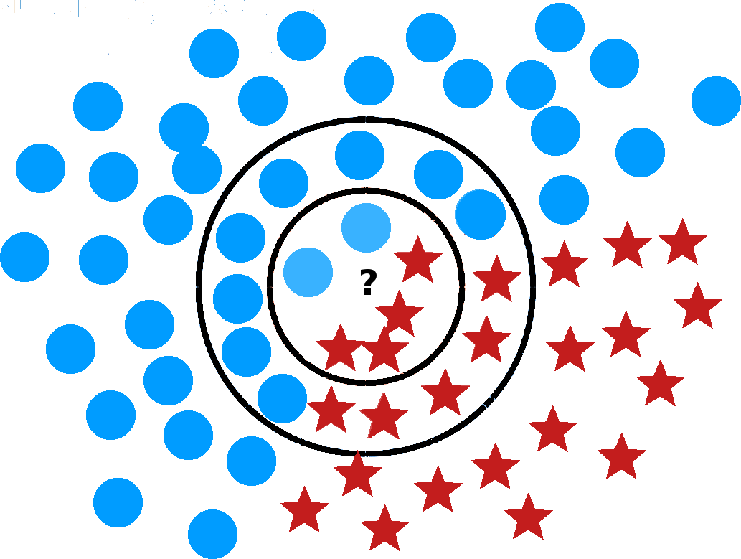
$k$ Nearest Neighbours

Slide 25
Support Vector Machines
[Adapted from Foster & Provost’s Data Science for Business]
Age
Margin
Balance

Slide 26
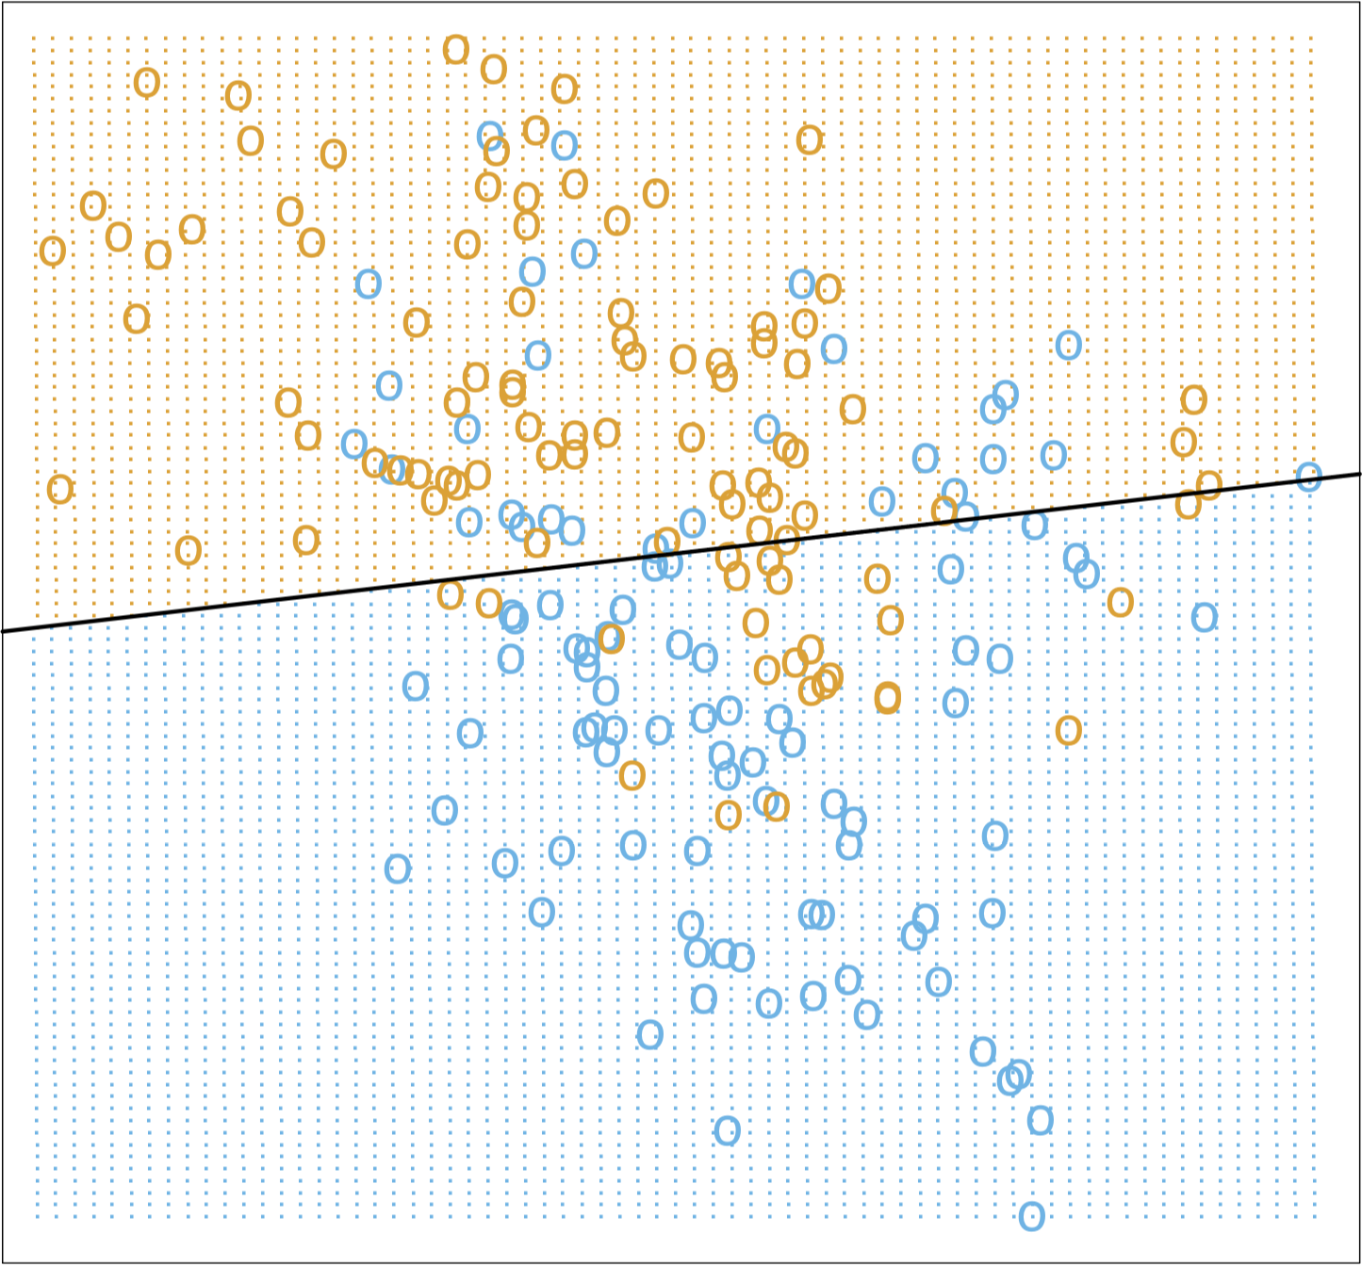
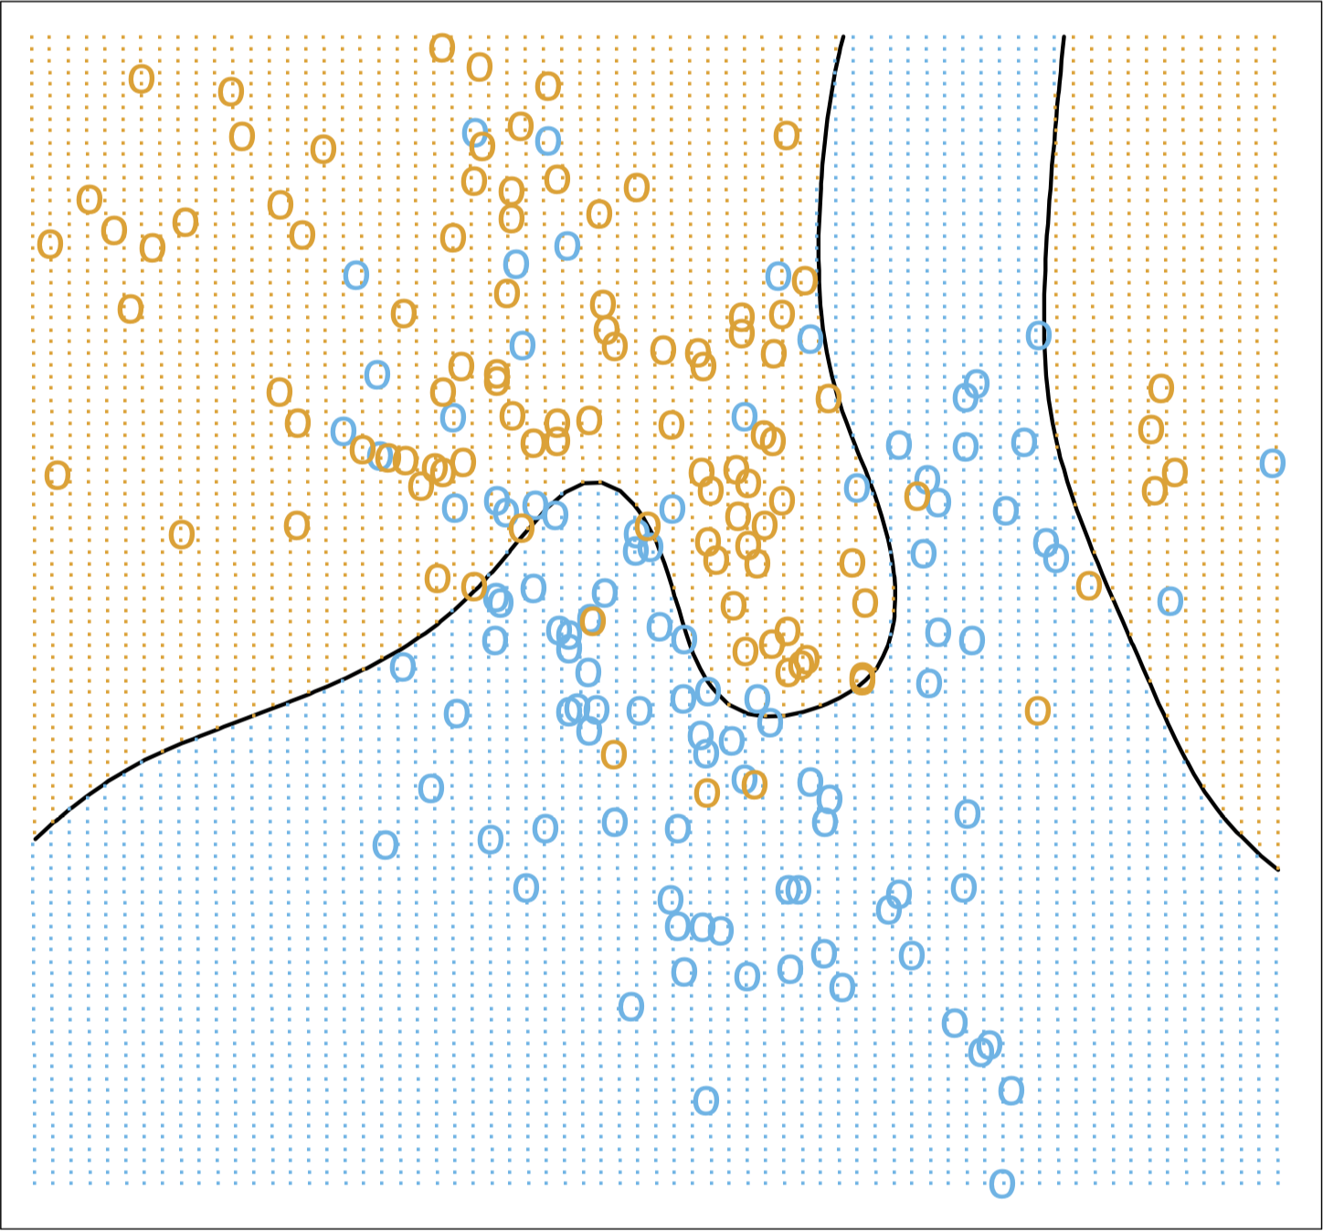
Illustration
[Images taken from The Elements of Statistical Learning]
Linear Regression Classifier
Optimal Bayes Classifier

Slide 27
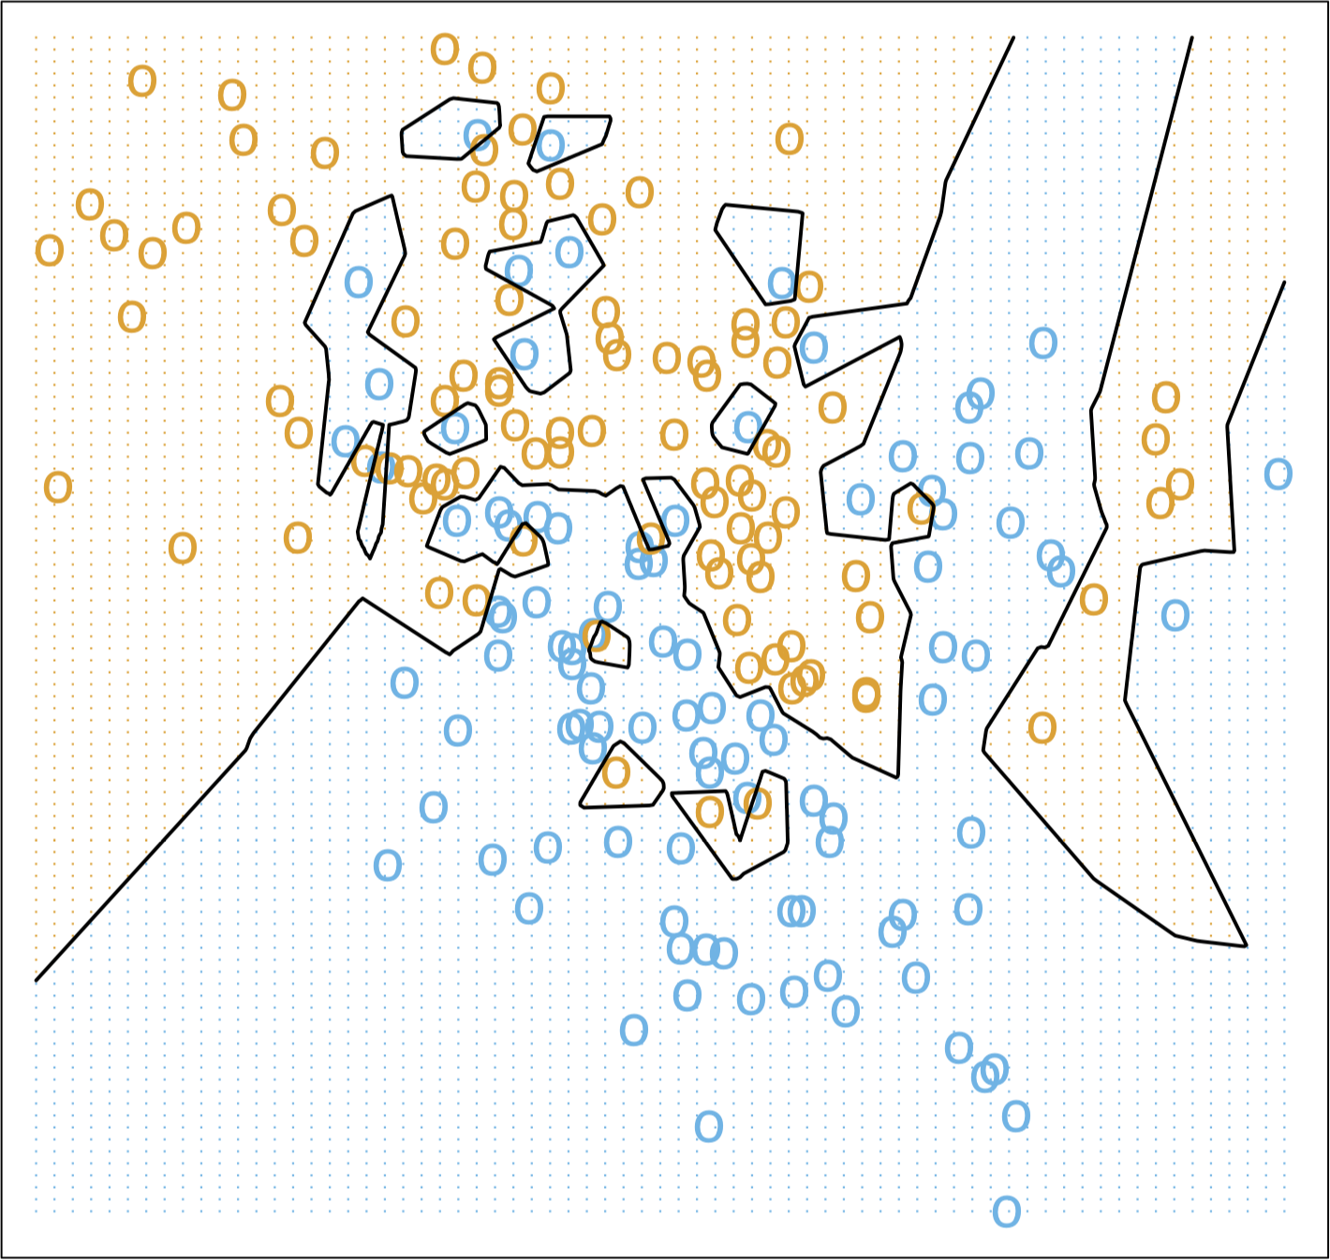
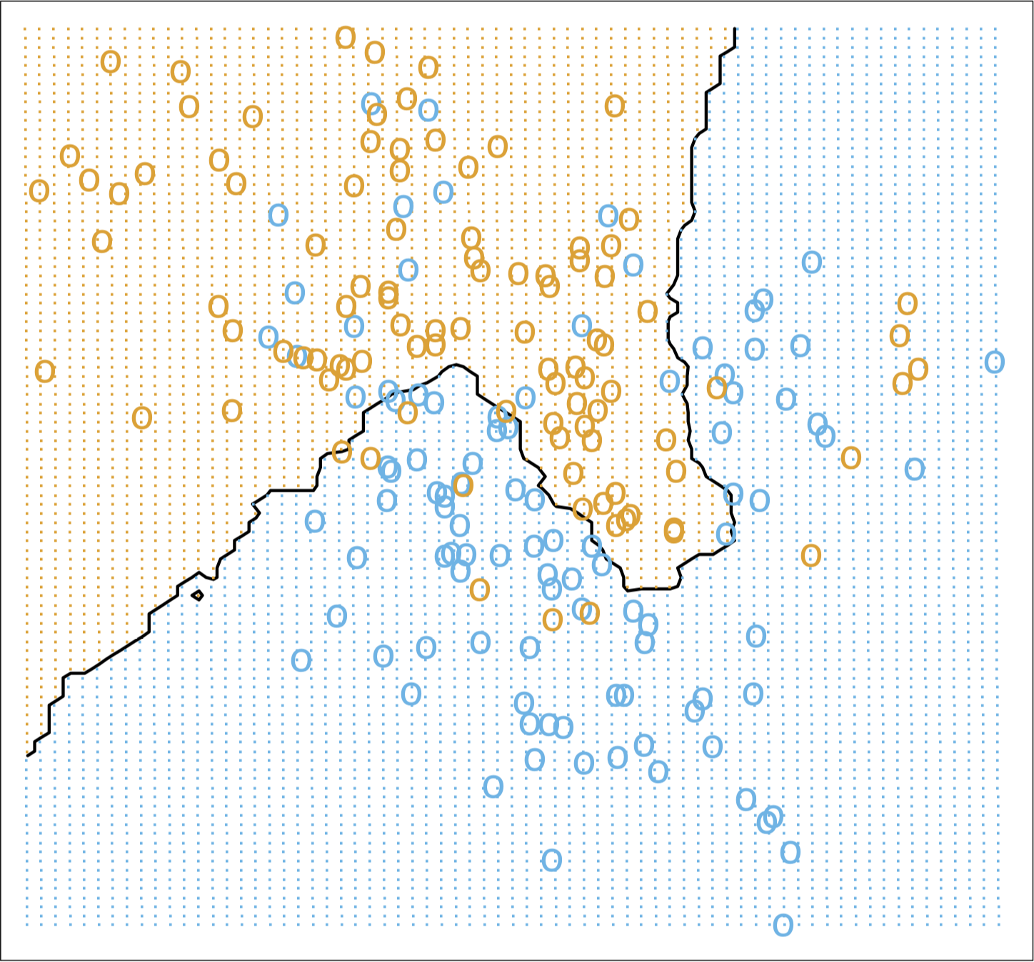
Illustration
[Images taken from The Elements of Statistical Learning]
1NN Classifier
15NN Classifier

Slide 28
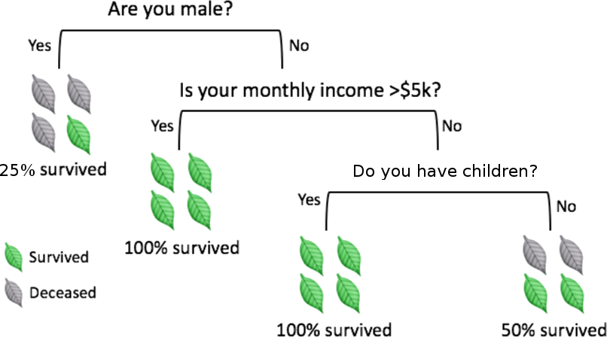
Decision Trees
[adapted from A. Ng, K. Soo, Numsense!, Surviving a Disaster]
Decision trees are perhaps the most intuitive of these methods: classification is achieved by following a path up the tree, from its root, through its branches, and ending at its leaves.

Slide 29
Decision Trees
To make a prediction for a new instance, follow the path down the tree, reading the prediction directly once a leaf is reached.
Creating the tree and traversing it might be time-consuming if there are too many variables.
Prediction accuracy can be a concern in trees whose growth is unchecked. In practice, the criterion of purity at the leaf-level is linked to bad prediction rates for new instances.
other criteria are often used to prune trees, which may lead to impure leaves (i.e. with non-trivial entropy).

Slide 30
Decision Tree Algorithm (ID3)
Task: grow a decision tree using a training set (a subset of the data for which the correct classification of the target is known).
Overview:
Split the training data (parent) set into (children) subsets, using the different levels of a particular attribute
Compute the information gain for each subset
Select the most advantageous split
Repeat for each node until some leaf criterion is met (each item in the leaf has the same classification?)

Slide 31
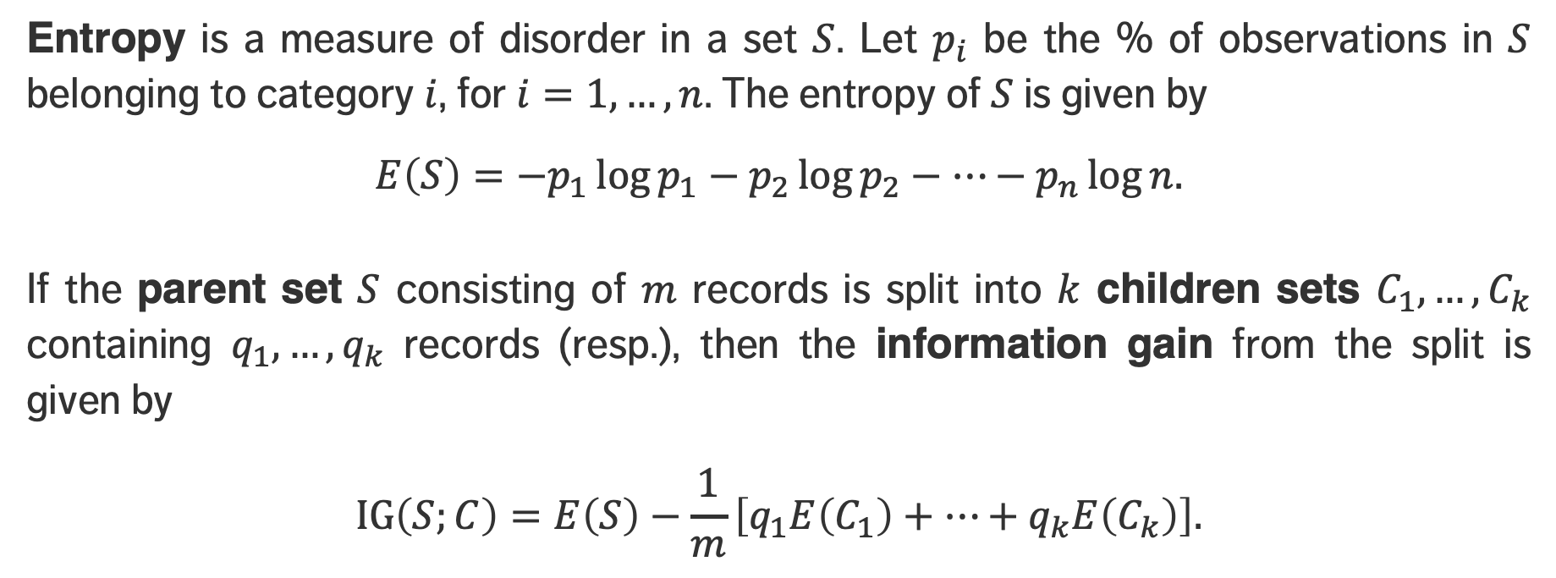
Information Gain
Entropy is a measure of disorder in a set $S$. Let $p_{i}$ be the % of observations in $S$ belonging to category $i$, for $i=1,…,n$. The entropy of $S$ is given by
$$E\left(S\right)=−p_{1}\log{p_{1}}−p_{2}\log{p_{2}}−…−p_{n}\log{n.}$$
If the parent set $S$ consisting of $m$ records is split into $k$ children sets $C_{1}, …,C_{k}$ containing $q_{1}, …,q_{k}$ records (resp.), then the information gain from the split is given by
$$\text{IG}\left(S;C\right)=E\left(S\right)−\frac{1}{m}\left[q_{1}E\left(C_{1}\right)+…+q_{k}E\left(C_{k}\right)\right].$$

Slide 32
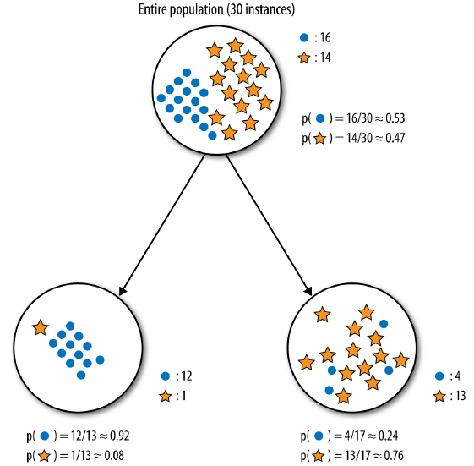
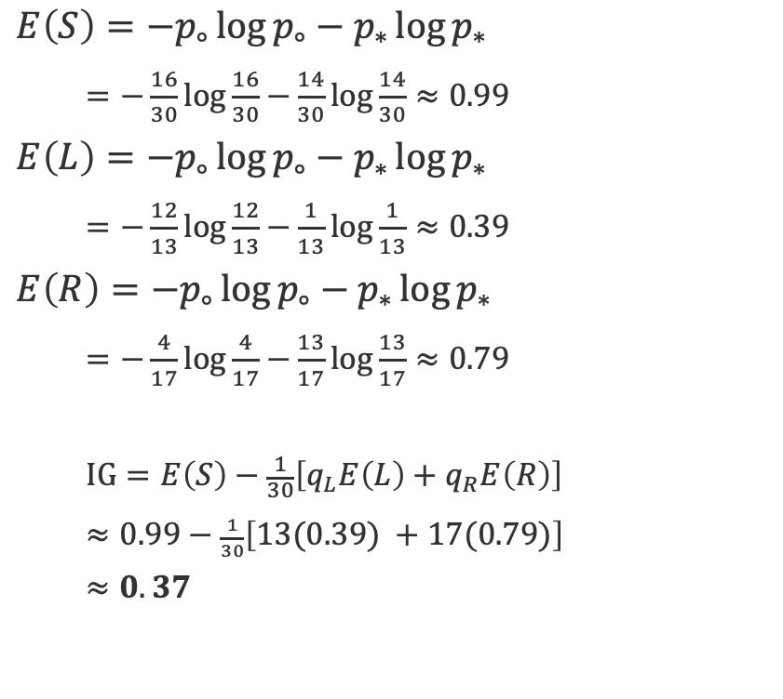
[Provost & Fawcett, Data Science for Business]
$$E\left(S\right)=−p_{∘}\log{p_{∘}}−p_{∗}\log{p_{∗}}$$
$=−\frac{16}{30}\log{\frac{16}{30}}$ $−\frac{14}{30}\log{\frac{14}{30}}≈0.99$
$$E\left(L\right)=−p_{∘}\log{p_{∘}}−p_{∗}\log{p_{∗}}$$
$=−\frac{12}{13}\log{\frac{12}{13}}$ $−\frac{1}{13}\log{\frac{1}{13}}≈0.39$
$$E\left(R\right)=−p_{∘}\log{p_{∘}}−p_{∗}\log{p_{∗}}$$
$=−\frac{4}{17}\log{\frac{4}{17}}$ $−\frac{13}{17}\log{\frac{13}{17}}≈0.79$
$$\text{IG}=E\left(S\right)−\frac{1}{30}\left[q_{L}E\left(L\right)+q_{R}E\left(R\right)\right]$$
$≈0.99−$ $\frac{1}{30}\left[13(0.39) +17(0.79)\right]$
$$≈0.37$$

Slide 33
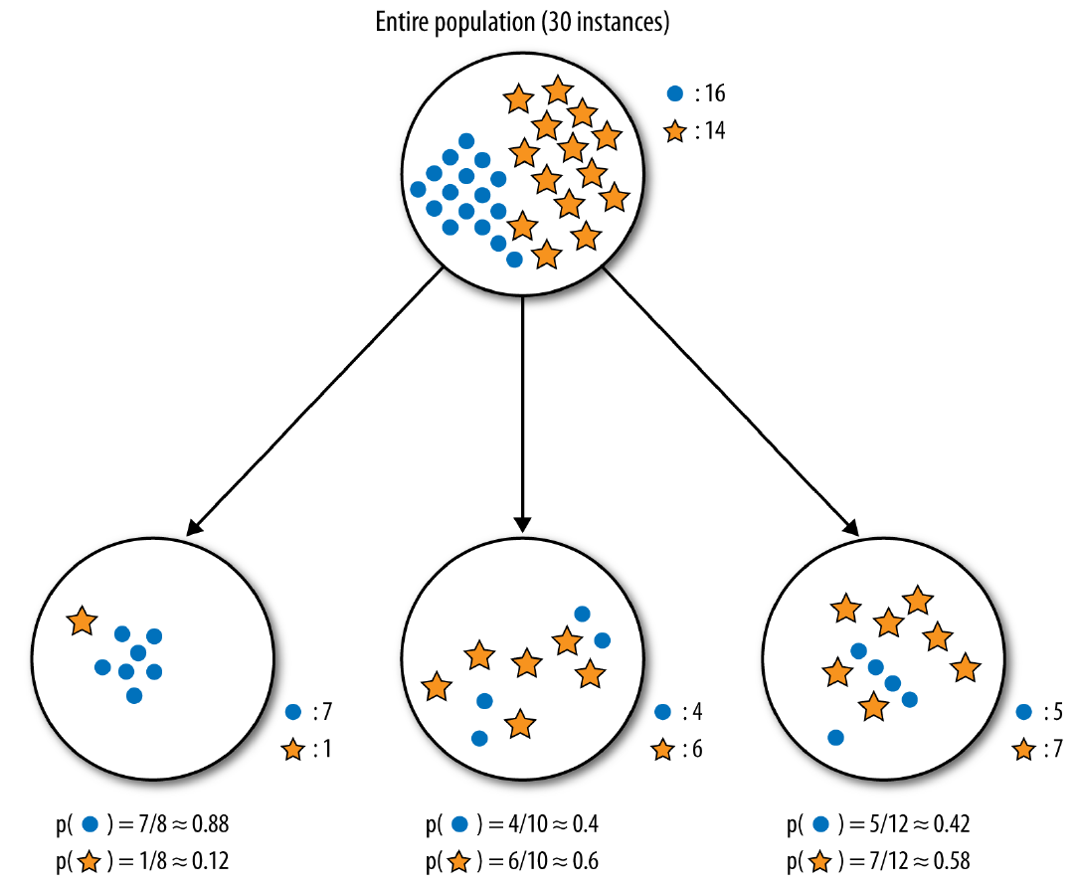
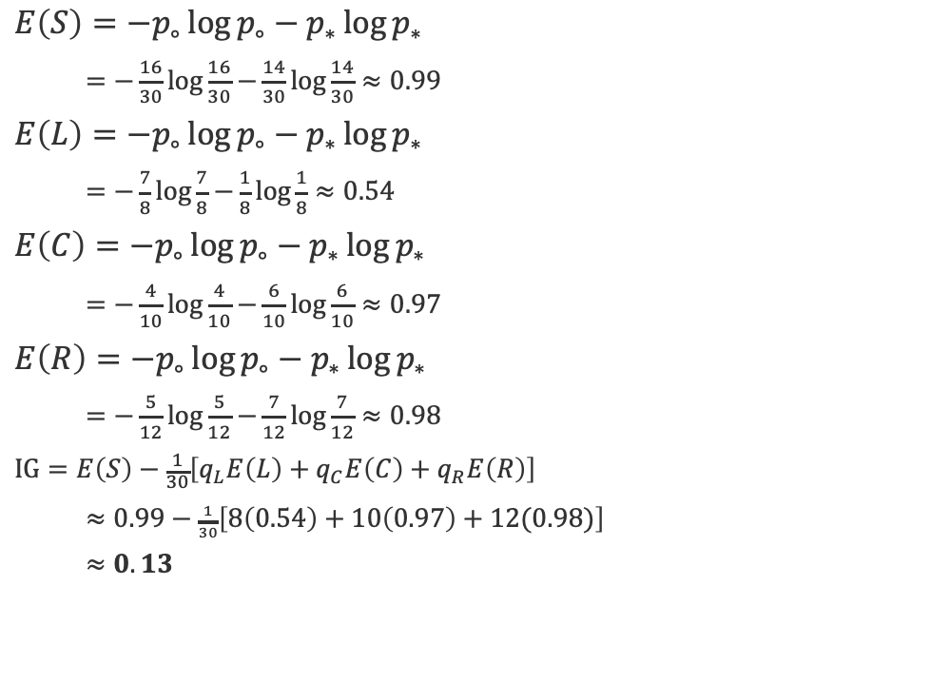
[Provost & Fawcett, Data Science for Business]
$$E\left(S\right)=−p_{∘}\log{p_{∘}}−p_{∗}\log{p_{∗}}$$
$=−\frac{16}{30}\log{\frac{16}{30}}$ $−\frac{14}{30}\log{\frac{14}{30}}≈0.99$
$$E\left(L\right)=−p_{∘}\log{p_{∘}}−p_{∗}\log{p_{∗}}$$
$=−\frac{7}{8}\log{\frac{7}{8}}$ $−\frac{1}{8}\log{\frac{1}{8}}≈0.54$
$$E\left(C\right)=−p_{∘}\log{p_{∘}}−p_{∗}\log{p_{∗}}$$
$=−\frac{4}{10}\log{\frac{4}{10}}$ $−\frac{6}{10}\log{\frac{6}{10}}≈0.97$
$$E\left(R\right)=−p_{∘}\log{p_{∘}}−p_{∗}\log{p_{∗}}$$
$=−\frac{5}{12}\log{\frac{5}{12}}$ $−\frac{7}{12}\log{\frac{7}{12}}≈0.98$
$$\text{IG}=E\left(S\right)−\frac{1}{30}\left[q_{L}E\left(L\right)+q_{C}E\left(C\right)+q_{R}E\left(R\right)\right]$$
$≈0.99−$ $\frac{1}{30}\left[8\left(0.54\right)+10\left(0.97\right)+12(0.98)\right]$
$$≈0.13$$

Slide 34
DISCUSSION
What split is most advantageous?
In what way does the choice of the algorithm(s) depend on the available data and data types, and on the prediction objective?
Notes:
Intro to text analysis
We will be talking about data reduction using NHL game between Ottawa Senators vs. Toronto Maple Leafs on February 18th of 2017

Slide 35
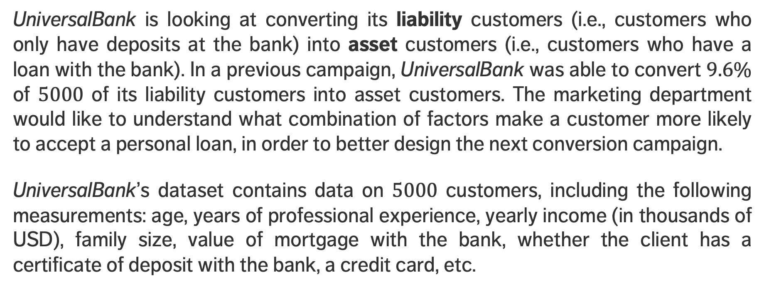
EXERCISE
[Shmueli et al., Data Mining for Business Analytics]
UniversalBank is looking at converting its liability customers (i.e., customers who only have deposits at the bank) into asset customers (i.e., customers who have a loan with the bank). In a previous campaign, UniversalBank was able to convert $9.6\%$ of $5000$ of its liability customers into asset customers. The marketing department would like to understand what combination of factors make a customer more likely to accept a personal loan, in order to better design the next conversion campaign.
UniversalBank’s dataset contains data on $5000$ customers, including the following measurements: age, years of professional experience, yearly income (in thousands of USD), family size, value of mortgage with the bank, whether the client has a certificate of deposit with the bank, a credit card, etc.
Notes:
Intro to text analysis
We will be talking about data reduction using NHL game between Ottawa Senators vs. Toronto Maple Leafs on February 18th of 2017

Slide 36
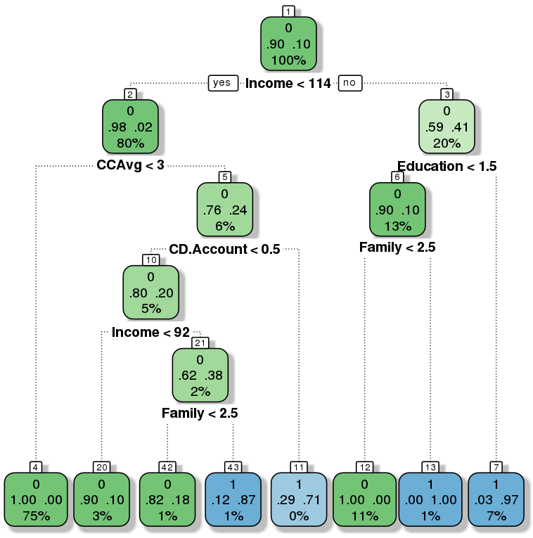
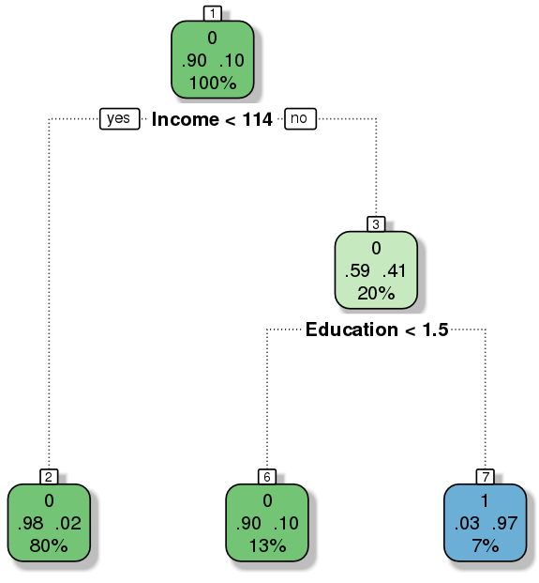
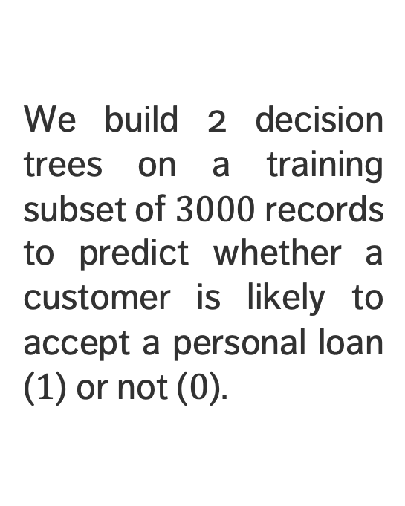
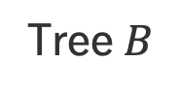
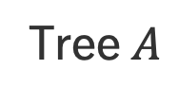
EXERCISE
[Shmueli et al., Data Mining for Business Analytics]
We build 2 decision trees on a training subset of $3000$ records to predict whether a customer is likely to accept a personal loan ($1$) or not ($0$).
Tree $A$
Tree $B$
Notes:
Intro to text analysis
We will be talking about data reduction using NHL game between Ottawa Senators vs. Toronto Maple Leafs on February 18th of 2017

Slide 37
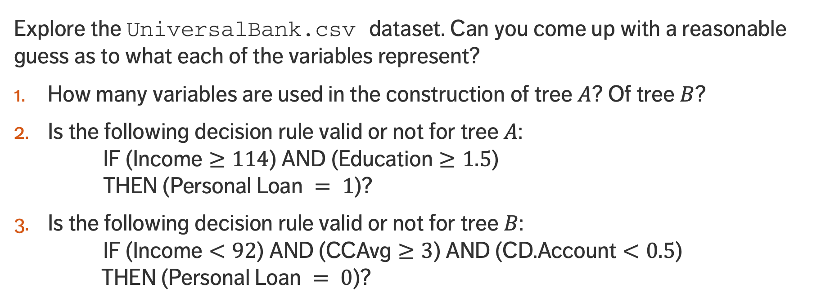
EXERCISE
Explore the UniversalBank.csv dataset. Can you come up with a reasonable guess as to what each of the variables represent?
How many variables are used in the construction of tree $A$? Of tree $B$?
Is the following decision rule valid or not for tree $A$: IF ($\text{Income}≥114$) AND ($\text{Education}≥1.5$) THEN ($\text{Personal} \text{Loan} = 1$)?
Is the following decision rule valid or not for tree $B$: IF ($\text{Income}<92$) AND ($\text{CCAvg}≥3$) AND ($\text{CD}\text{.}\text{Account}<0.5$) THEN ($\text{Personal} \text{Loan} = 0$)?

Slide 38
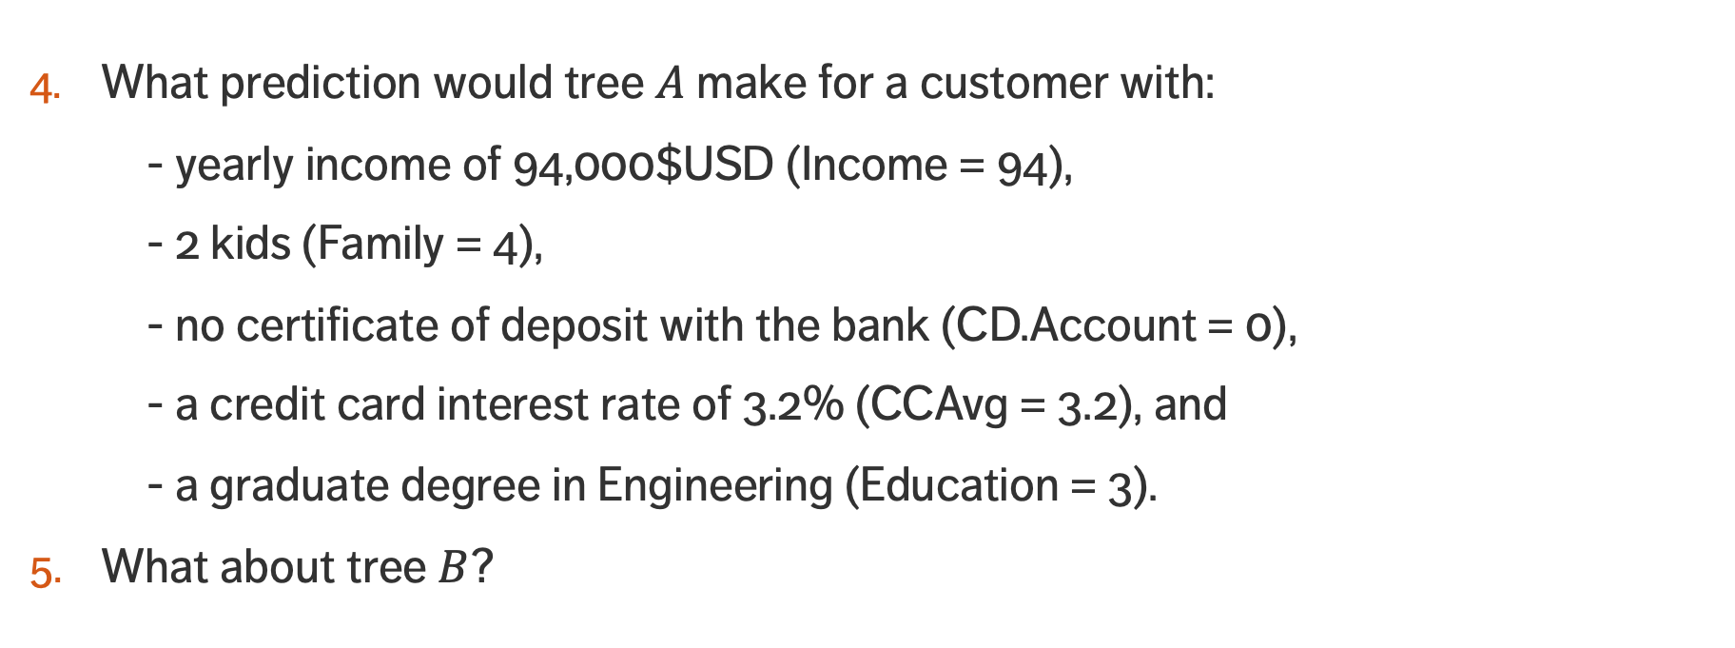
EXERCISE
What prediction would tree $A$ make for a customer with:
- yearly income of 94,000$USD ($\text{Income}\text{ = 94}$),
- 2 kids ($\text{Family}\text{ = 4}$),
- no certificate of deposit with the bank ($\text{CD}\text{.}\text{Account}\text{ = 0}$),
- a credit card interest rate of 3.2% ($\text{CCAvg}\text{ = 3.2}$), and
- a graduate degree in Engineering ($\text{Education}\text{ = 3}$).
What about tree $B$?

Slide 39
NOTES AND VALIDATION
CLASSIFICATION AND VALUE ESTIMATION
“Random trees, and forests, and jungles, oh my!!”
(unknown)

Slide 40
Decision Trees Strengths
White box model
predictions can always be explained by following the appropriate paths
Can be used with incomplete datasets
Built-in feature selection
less relevant features don’t tend to be used as splitting features
Makes no assumption about
independence, constant variance, underlying distributions, co-linearity

Slide 41
Decision Trees Limitations
Not as accurate as other algorithms (usually)
Not robust: small changes in the training dataset can lead to a completely different tree, with a completely different predictions
Particularly vulnerable to overfitting in the absence of pruning
pruning procedures are typically convoluted
Optimal decision tree learning is NP-complete
Biased towards categorical features with high number of levels

Slide 42
Decision Trees Notes
Splitting Metrics
information gain, Gini impurity, variance reduction, etc.
Common Algorithms
Iterative Dichotomiser 3, C4.0, C4.5, CHAID, MARS, conditional inference trees, CART
Decision trees can also be combined together using boosting algorithms (AdaBoost) or Random Forests, providing a type of voting procedure (Ensemble Learning).

Slide 43
Other Points to Ponder
Classification is linked to probability estimation
approaches based on regression models could prove fruitful
Rare occurrences (often more interesting or important) continue to plague classification attempts
historical data at Fukushima's nuclear reactor prior to the meltdown could not have been used to learn about meltdowns
No Free-Lunch Theorem: no classifier works best for all data.
With big datasets, algorithms must also consider efficiency.

Slide 44
Performance Evaluation
Classifiers are evaluated on the testing set.
Ideally, a good classifier would have high rates of both True Positives (TP) and True Negatives (TN), and low rates of both False Positives (FP, Type I error) and False Negatives (FN, Type II error).
Evaluation metrics mean very little on their own: context requires comparison with other classifiers, and other evaluation metrics.

Slide 45
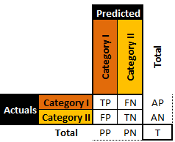
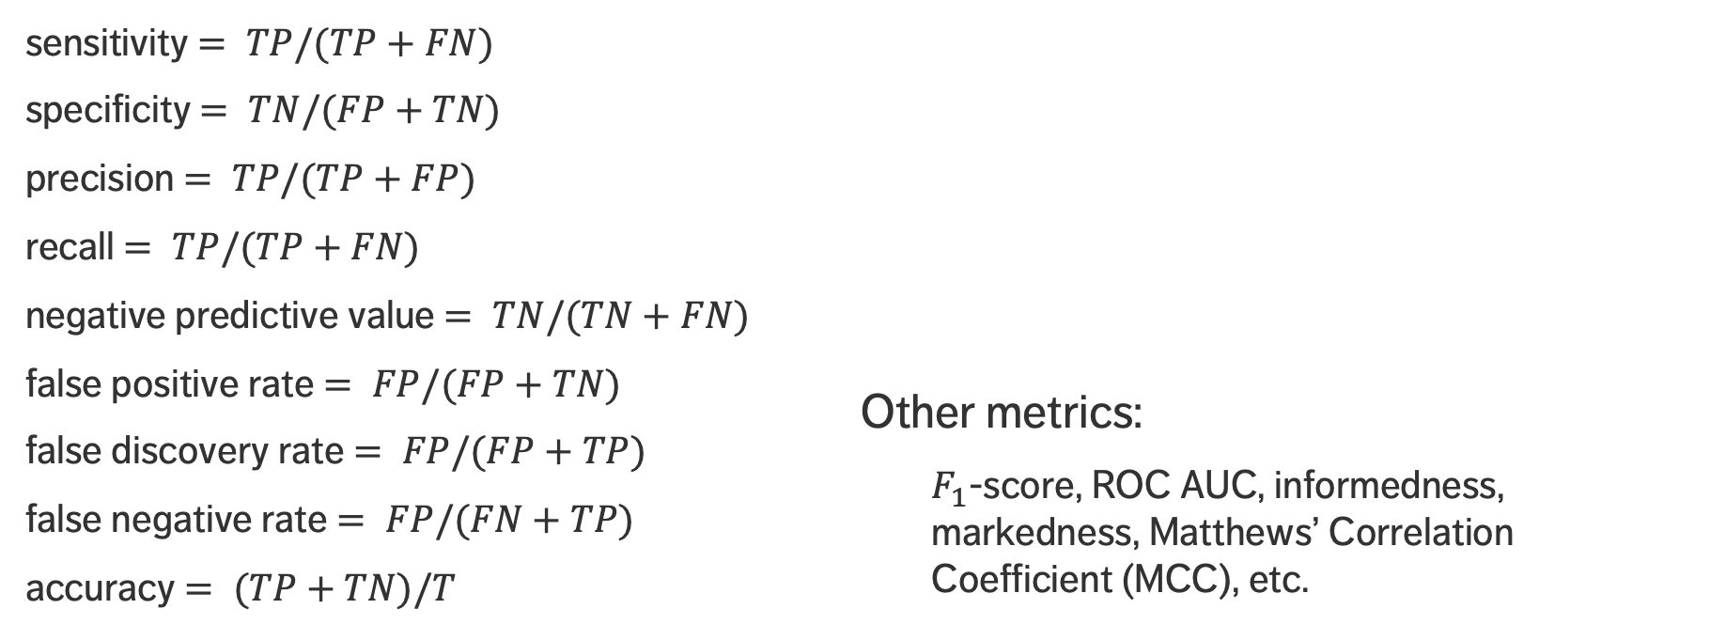
Performance Evaluation
sensitivity $= TP/(TP+FN)$
specificity $= TN/(FP+TN)$
precision $= TP/(TP+FP)$
recall $= TP/(TP+FN)$
negative predictive value $= TN/(TN+FN)$
false positive rate $= FP/(FP+TN)$
false discovery rate $= FP/(FP+TP)$
false negative rate $= FP/(FN+TP)$
accuracy $= (TP+TN)/T$
Other metrics:
$F_{1}$-score, ROC AUC, informedness, markedness, Matthews’ Correlation Coefficient (MCC), etc.

Slide 46
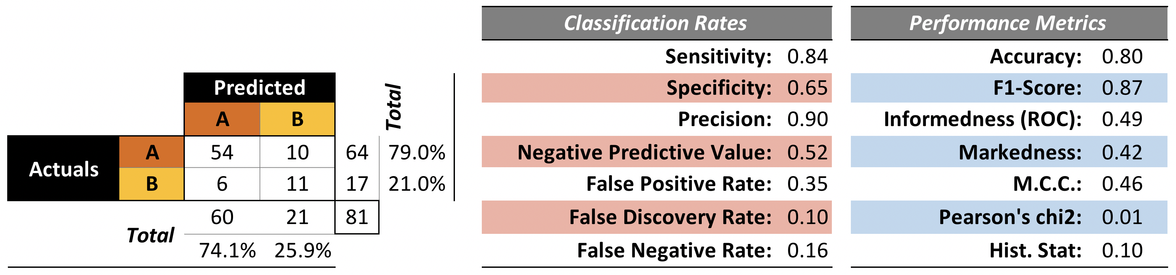
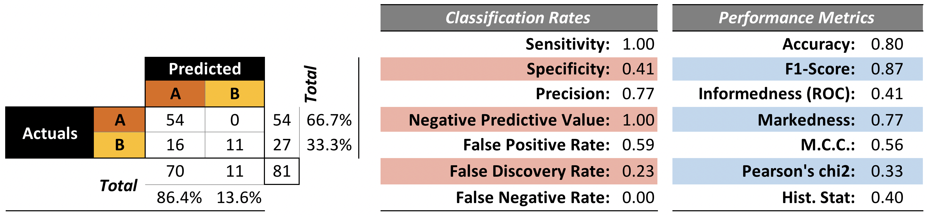

Slide 47
DISCUSSION
How many predictive models should be built to deal with supervised tasks, in general?
Notes:
Intro to text analysis
We will be talking about data reduction using NHL game between Ottawa Senators vs. Toronto Maple Leafs on February 18th of 2017

Slide 48
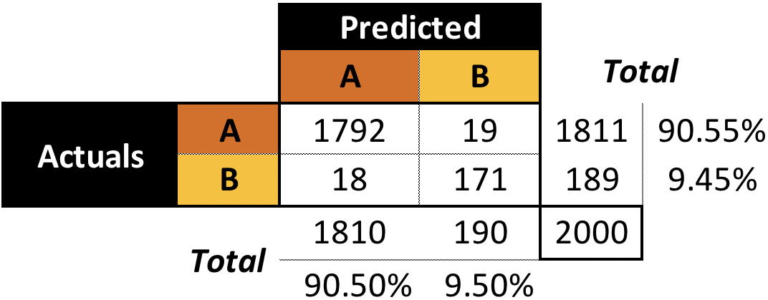
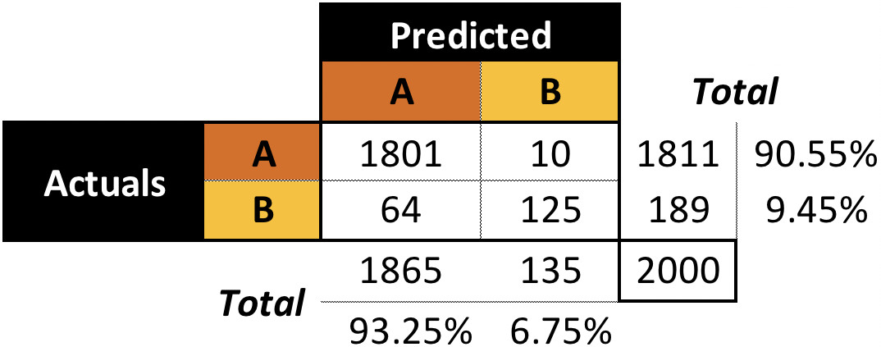
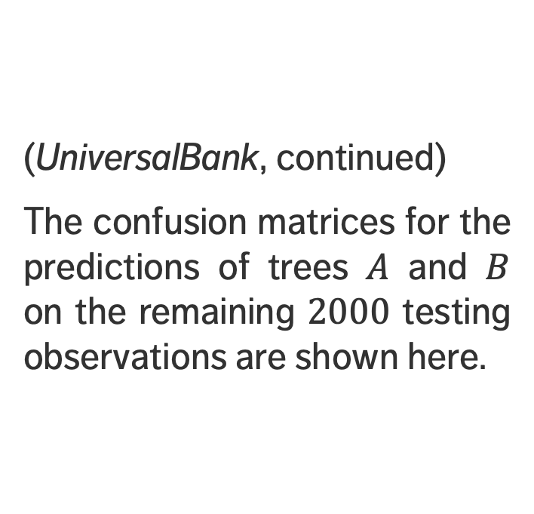
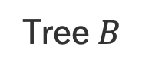
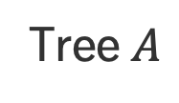
EXERCISE
(UniversalBank, continued)
The confusion matrices for the predictions of trees $A$ and $B$ on the remaining $2000$ testing observations are shown here.
Tree $A$
Tree $B$
Notes:
Intro to text analysis
We will be talking about data reduction using NHL game between Ottawa Senators vs. Toronto Maple Leafs on February 18th of 2017

Slide 49
EXERCISE
Using the appropriate matrices, compute the 9 performance evaluation metrics for each of the trees (on the testing set).
If customers who would not accept a personal loan get irritated when offered a personal loan, what tree should UniversalBank’s marketing group use to help maintain good customer relations?

Slide 50
EXAMPLE: KYPHOSIS
CLASSIFICATION AND VALUE ESTIMATION
“My misfortune is that I still resemble a man too much. I should liked to be wholly a beast like that goat.”
(V. Hugo, The Hunchback of Notre Dame)

Slide 51
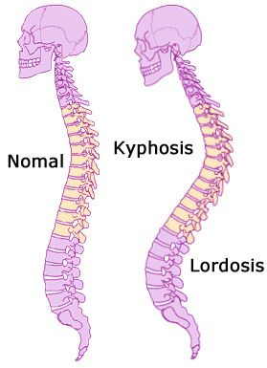
Example – Kyphosis Dataset
Kyphosis is a medical condition related to the excessive convex curvature of the spine. Corrective spinal surgery is at times performed on children.
The dataset has 81 observations and 4 attributes:
kyphosis (absent or present after operation)
age (at time of operation, in months)
number (of vertebrae involved)
start (topmost vertebra operated on)

Slide 52
Example – Kyphosis Dataset
The question of interest for this natural dataset is how the three explanatory attributes might impact the operation’s success.
We use the rpart implementation of CART to generate candidate decision trees.
Strictly speaking, this is not a predictive supervised task as we treat the entire dataset as a training set (there are no hold-out testing observations for the time being).
Notes:
Intro to text analysis
We will be talking about data reduction using NHL game between Ottawa Senators vs. Toronto Maple Leafs on February 18th of 2017

Slide 53
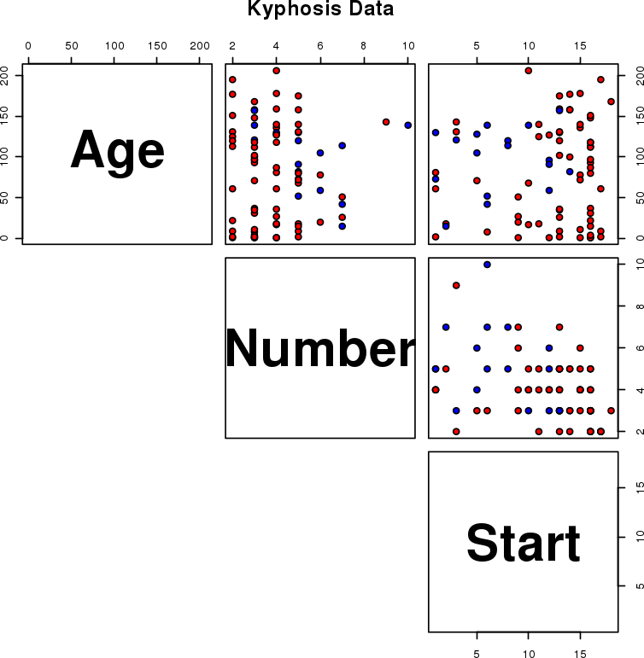
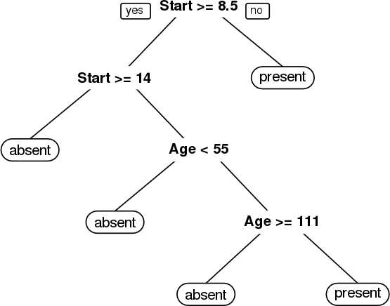
Example – Kyphosis Dataset
present
absent

Slide 54
Example – Kyphosis Dataset
present
absent

Slide 55
Example – Kyphosis Dataset
present
absent

Slide 56
Example – Kyphosis Dataset
present
absent

Slide 57
Example – Kyphosis Dataset
present
absent

Slide 58
Example – Kyphosis Dataset
present
absent

Slide 59
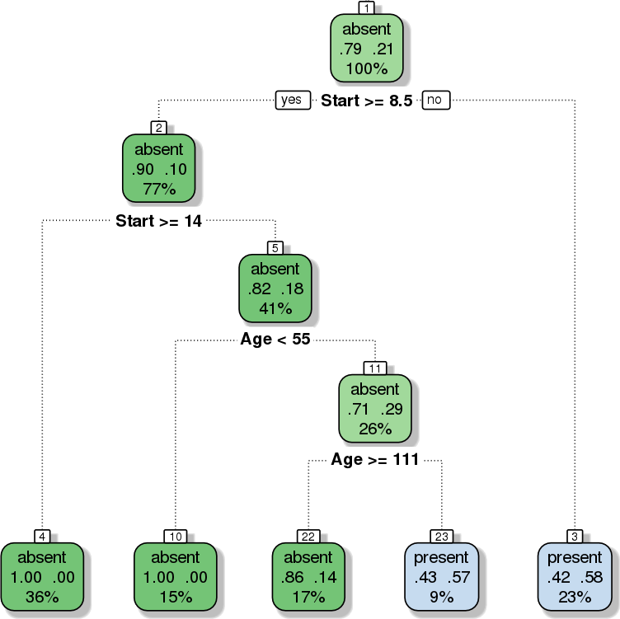
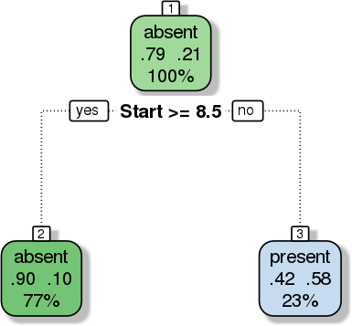
Classification of kyphosis dataset
Pruned classification of kyphosis dataset

Slide 60
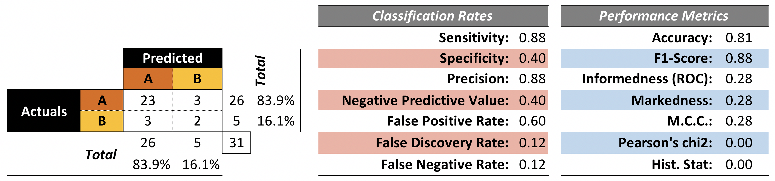
Example – Kyphosis Dataset
We train a model on 50 observations (selected randomly) and evaluate the performance on the remaining 31 observations.
We train a model on 50 observations (selected randomly) and evaluate the performance on the remaining 31 observations.

Slide 61
DISCUSSION
Is this a good model?
Notes:
Intro to text analysis
We will be talking about data reduction using NHL game between Ottawa Senators vs. Toronto Maple Leafs on February 18th of 2017

Slide 62
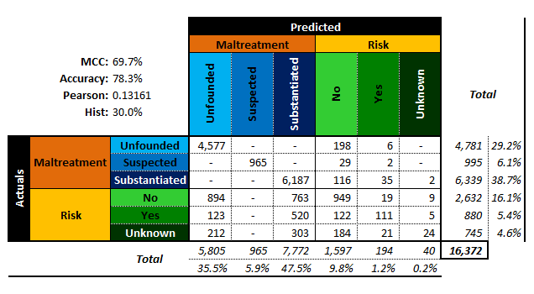
Most performance metrics do not generalize to the multinomial case.

Slide 63
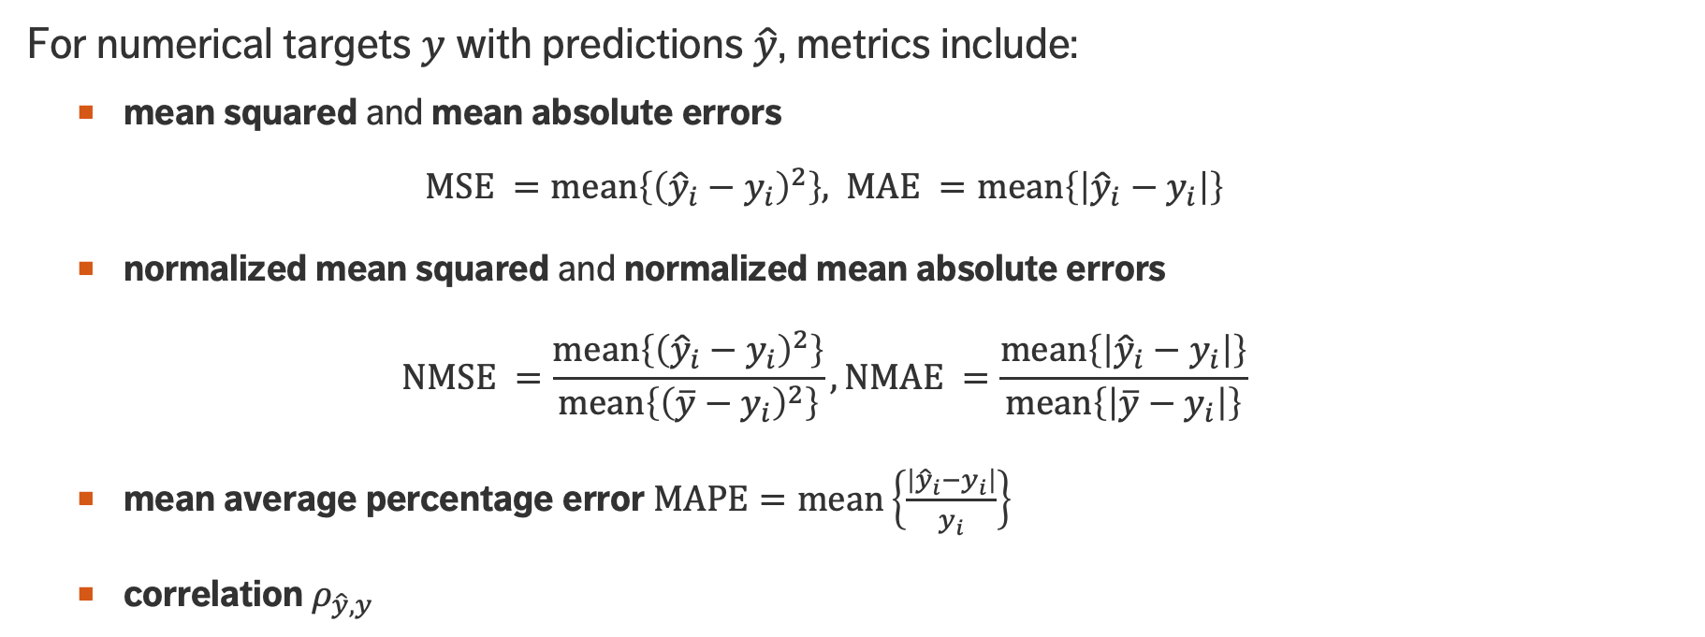
Performance Evaluation
For numerical targets $y$ with predictions $\hat{y}$, metrics include:
mean squared and mean absolute errors
$$\text{MSE} =\text{mean}\left\{{\left({\hat{y}}_{i}−y_{i}\right)}^{2}\right\}\text{, }\text{MAE} =\text{mean}\left\{\left|{\hat{y}}_{i}−y_{i}\right|\right\}$$
normalized mean squared and normalized mean absolute errors
$$\text{NM}\text{SE} =\frac{\text{mean}\left\{{\left({\hat{y}}_{i}−y_{i}\right)}^{2}\right\}}{\text{mean}\left\{{\left(\overline{y}−y_{i}\right)}^{2}\right\}},\text{NMAE} =\frac{\text{mean}\left\{\left|{\hat{y}}_{i}−y_{i}\right|\right\}}{\text{mean}\left\{\left|\overline{y}−y_{i}\right|\right\}}$$
mean average percentage error $MAPE=\text{mean}\left\{\frac{\left|{\hat{y}}_{i}−y_{i}\right|}{y_{i}}\right\}$
correlation $ρ_{\hat{y},y}$

Slide 64
PERFORMANCE EVALUATION
In both the categorical and numerical estimation problem, isolated performance metric does not provide enough of a rationale for model validation, unless it has first been normalized.
There is (a lot) more to be said on the topic of model selection.
Notes:
Intro to text analysis
We will be talking about data reduction using NHL game between Ottawa Senators vs. Toronto Maple Leafs on February 18th of 2017

Slide 65
References
CLASSIFICATION AND VALUE ESTIMATION

Slide 66
Supplemental Material
Value Estimation Methods https://www.data-action-lab.com/wp-content/uploads/2019/03/Value-Estimation-Methods.pdf
Logistic Regression https://www.data-action-lab.com/wp-content/uploads/2019/03/Logistic-Regression.pdf
Naïve Bayes Classification https://www.data-action-lab.com/wp-content/uploads/2019/03/Naïve-Bayes-Classification.pdf
Notebooks https://www.data-action-lab.com/wp-content/uploads/2019/03/Classification.zip

Slide 67
References
Kitts, B., Zhang, J., Wu, G., Brandi, W., Beasley, J., Morrill, K., Ettedgui1, J., Siddhartha, S., Yuan, H., Gao, F., Azo, P., Mahato, R. (in press), Click Fraud Detection: Adversarial Pattern Recognition over 5 Years at Microsoft, Annals of Information Systems Special Issue on Data Mining in Real-World Applications.
Kitts, B. (2013), The Making of a Large-Scale Ad Server, in Data Mining Case Studies Workshop and Practice Prize 5, Proceedings of the IEEE Thirteenth International Conference on Data Mining Workshops (ICDMW 2013), December, Dallas, TX, IEEE Press.
Fefilatyev, S., Kramer, K., Hall, L., Goldgof, D., Kasturi, R., Remsen, A., Daly, K. (2011), Detection of Anomalous Particles from Deepwater Horizon Oil Spill Using SIPPER3 Underwater Imaging Platform, in Data Mining Case Studies IV, Proceedings of the Eleventh IEEE International Conference on Data Mining, Vancouver, Canada
Kitts, B. (2005), Product Targeting From Rare Events: Five Years of One-to-One Marketing at CPI, Marketing Science Conference, Atlanta, June 2005.

Slide 68
References
https://algobeans.com/2016/07/27/decision-trees-tutorial/
https://en.wikipedia.org/wiki/Decision_tree_learning
https://en.wikipedia.org/wiki/Predictive_analytics
https://en.wikipedia.org/wiki/Multivariate_adaptive_regression_splines
https://en.wikipedia.org/wiki/Evaluation_of_binary_classifiers
Aggarwal, C.C. (ed.) [2015], Data Classification: Algorithms and Applications, CRC Press.
Leskovec, J., Rajamaran, A., Ullman, J.D. [2014], Mining of Massive Datasets, Cambridge Press.
Provost, F., Fawcett, T. [2013], Data Science for Business, O'Reilly.

Slide 69
References
Naïve Bayes Classifier (Wikipedia)
Zhang, H. (2014) The optimality of Naïve Bayes
Domings, P., and Pazzani, M. (1997) Beyond independence: Conditions for the optimality of the simple Bayesian classifier
Markham, K. Scikit-learn video #3: Machine learning first steps with the Iris dataset
http://www.ee.columbia.edu/~vittorio/BayesProof.pdf
https://www.cs.cmu.edu/~epxing/Class/10701-08s/Lecture/lecture3-annotated.pdf
http://www.cogsys.wiai.uni-bamberg.de/teaching/ss05/ml/slides/cogsysII-9.pdf

